Slide 1

EL Instructional Academy WS# 117542
Karina E. Chapa, M.Ed.
Language Proficiency, Biliteracy and Cultural Diversity Director
kchapa@esc1.net
@bilingualpride @esc1bilingual

Slide 2

Intellectual Property Statement
All materials, content, and forms contained in this training/presentation are the intellectual property of the Region One Education Service Center and are intended for use by session participant at the classroom, campus, or district level only. Materials are to be used “as is” without modification.
Materials may not be used for personal benefit or financial gain or for use outside of the school system.
www.esc1.net│facebook.com/RegionOneEducationServiceCenter│twitter.com/RegionOneESC

Slide 3

Professional Learning Essential Agreements
Be respectful
Be an active participant
Take care of your needs
Use electronic devices as learning tools

Slide 4




Karina Elizabeth Zuno Cooley
“Karina Chapa”

Slide 5
EL leadership academy
Rationale

Slide 6
English Learners in Texas
160,000+
in Region One
Source: TEA, 2018

Slide 7
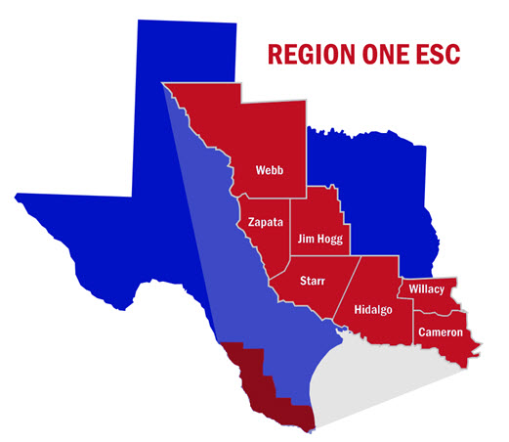
Languages in Our Region
Home Language | Students
Spanish | 256,800
English | 173,050
Tagalog (Filipino) | 228
Vietnamese | 139
Korean | 92
Arabic | 70
Mandarin | 56
40 languages more | 593
TOTAL | 436,115
59.5%
40%
>0.5%

Slide 8
Changing Texas: 2050
Average Age
NHW 42
HW 28
Population
NHW 2%
HW 70%
Workforce
H vs NH
3:1
ECONOMIC
PRECIPICE
“In the absence of change, the Texas labor force as a whole will be less-educated, work in lower-status occupations, and have lower incomes in 2050 than 2010”
Steve Murdock, 2013

Slide 9
Changing Texas: 2050
Average Age
NHW 42
HW 28
Population
NHW 2%
HW 70%
Workforce
H vs NH
3:1
EDUCATION
FUTURE PROSPERITY
We are that CHANGE!

Slide 10
The Power of Region One
97% Hispanic
37% ELL PK-12
85% EcoDis
Region One TODAY
Texas in 30 Years

Slide 11
Second Language Acquisition
TELPAS-ELPS Connection
Sheltered Instruction

Slide 12
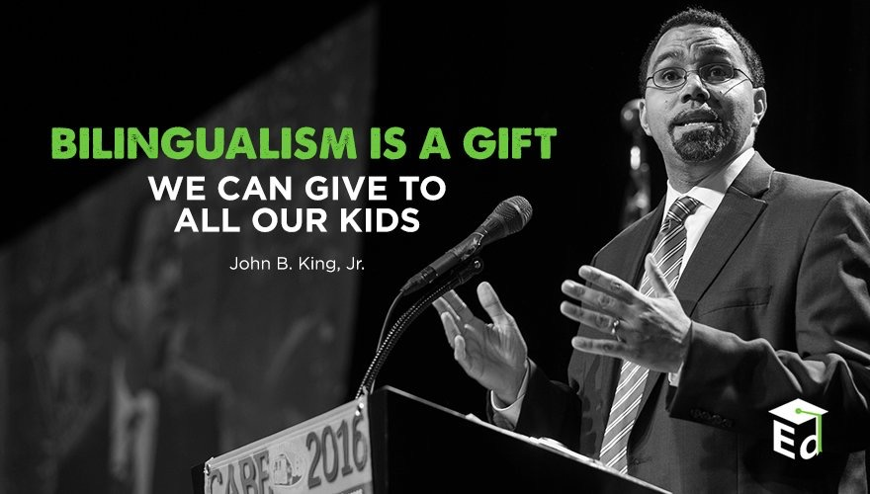
Second Language Acquisition
Notes:
45 mins

Slide 13
Session Objectives
Content Objective
Language Objective
Today I will analyze the second language acquisition process and understand its impact in the education of English Learners.
Today I will discuss with my peers the second language acquisition process and I will share orally and in writing my individual language profile.

Slide 14

SLA Anticipation Guide
Let’s
kahoot.it

Slide 15
Language Power
Cognitive
Social
Affective
“Language stands at the center of the many interdependent cognitive, affective, and social factors that shape learning”.
David Corson, 1999
LANGUAGE
=
IDENTITY
3-Step Interview

Slide 16
The Iceberg Theory
Basic Interpersonal Communication Skills
BICS
1-3 years
CALP
5-7 years
Cognitive Academic Language Proficiency
J. Cummins, 1981

Slide 17
Double Iceberg Theory
BICS L1 1-3 years
BICS L2 1-3 years
CALP L1+L2
5-7 years
J. Cummins, 1981

Slide 18
Transfer of Concepts
L1
L2
CALP
L1
L2
J. Cummins, 1981

Slide 19
In Other Words…
BICS L1
BICS L2
CALP
L1
L2
CALP Transfer L1-L2
J. Cummins, 1981

Slide 20
Research Findings
The stronger academically and cognitively the L1, the stronger the L2.
The weaker academically and cognitively the L1, the weaker the L2.
W. Thomas & V. Collier, 2009
Turn and Talk
Think-Pair-Share

Slide 21
My Language Profile
BICS Spanish
BICS English
CALP Spanish + English
1999

Slide 22
My Language Profile
BICS Spanish
BICS English
CALP Spanish + English
2019

Slide 23
Your Turn!
BICS L1
BICS L2
CALP L1+L2
Create your own language profile
Birthday Line
Notes:
90 mins

Slide 24
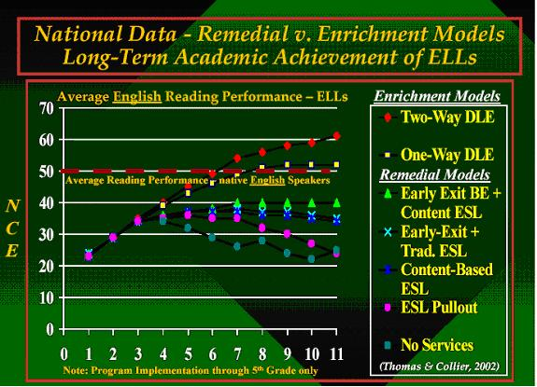
W. Thomas and V. Collier, 2002

Slide 25
Bilingual Program Models
Chapter 89, Jigsaw/Frayer Model
Bilingual Education
Subtractive ( - )
Submersion
Early Exit
Additive (+)
Late Exit
Dual Language
One-Way
Two-Way

Slide 26
Frayer Model
Early Exit
Late Exit
One-Way DL
Two-Way DL
Bilingual Program Models

Slide 27
Mingle!
ESL
Content Based
ESL
Pull-Out

Slide 28
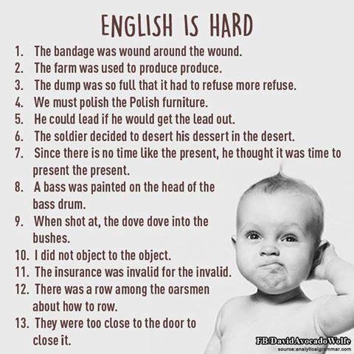

Slide 29
The Power of Cognates
La chimica è la scienza che studia la composizione della materia ed il suo comportamento in base a tale composizione.

Slide 30
The Power of Cognates
La chimica è la scienza che studia la composizione della materia ed il suo comportamento in base a tale composizione.

Slide 31
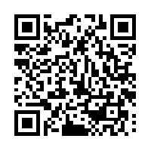
Your Turn!
1. Individually make a list of 5 academic words from any content area, except ELAR.
2. Turn to your partner and combine your two lists of words (even if from different content areas).
3. Write the Spanish translations next to each academic word. Use Google Translate if needed.
4. Calculate what percentage of the words are cognates.
1 – 2 – 4 – ALL
http://www.realfastspanish.com/vocabulary/spanish-cognates

Slide 32
English vs spanish
Phonology Awareness

Slide 33
Spanish vs English Phonology
Spanish
English
Based in syllables
mamá → ma-má
manzana → man-za-na
sol → sol
Based on phonemes
cat → /k/ /a/ /t/
bat → /b/ /a/ /t/
sat → /s/ /a/ /t/
rat → /r/ /a/ /t/

Slide 34

Spanish Phonology
FRONT
CENTER
BACK
iy (igual)
uw (uva)
HIGH
ε(ego)
ow (oso)
MEDIUM
a (al)
LOW

Slide 35
English Phonology
FRONT
CENTER
BACK
iy (meat)
I (mitt)
uw (pool)
Ư (pull)
HIGH
ey (mate) ε(met)
ə (mutt)
ow (coat)
MEDIUM
æ (mat)
a (pot)
o (caught)
LOW

Slide 36
Spanish vs English Phonology
English
Spanish
5 vowels = 11+ sounds
b / v = different sounds
You
bit / bite
bow / bow / vow
bath / bathe
5 vowels = 5 sounds
b / v = same sound
Tú / Usted
Closest sound to “th” in English is “d” in Spanish
It is raining→ Está lloviendo
Life is hard → La vida es dura

Slide 37
Factors that Impact Second Language Acquisition
Motivation and attitude
First language development
Age
Cultural background
Quality of instruction
Personality
Peers and role models
Access to the language
Language distance
Take a Stand

Slide 38
Five SLA Hypothesis
Acquisition vs Learning Hypothesis
Monitor Hypothesis
Natural Order Hypothesis
Input Hypothesis
Affective Filter Hypothesis

Slide 39
Expert Jigsaw: Tree Map
Krashen’s Five Hypothesis
Learning vs Acquisition
Monitor
Natural Order
Input
Affective Filter

Slide 40
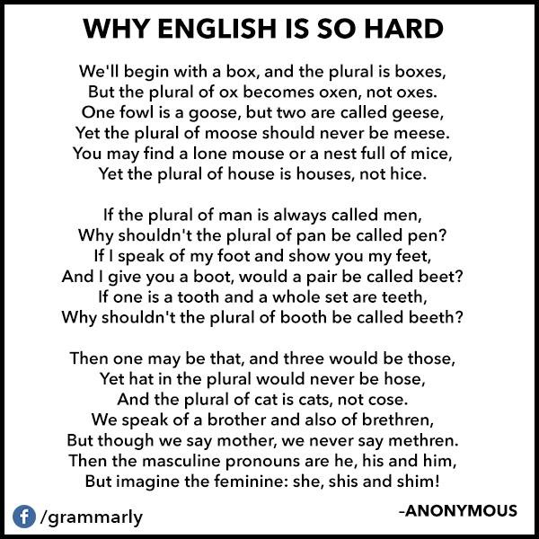

Slide 41
Session Objectives
Content Objective
Language Objective
Today I analyzed the second language acquisition process and understood its impact in the education of English Language Learners.
Today I discussed with my peers the second language acquisition process and I shared orally and in writing my individual language profile.

Slide 42

Tickets Out
I used to think…
But now I know…

Slide 43
Mil gracias
See you tomorrow!
Karina E. Chapa, M.Ed.
Language Proficiency, Biliteracy and Cultural Diversity Director
kchapa@esc1.net
Facebook: Region One ESC Bilingual
Twitter @esc1bilingual @bilingualpride

